Slide 1

Nashville City Cemetery
Mylah Kate Gainey

Slide 2
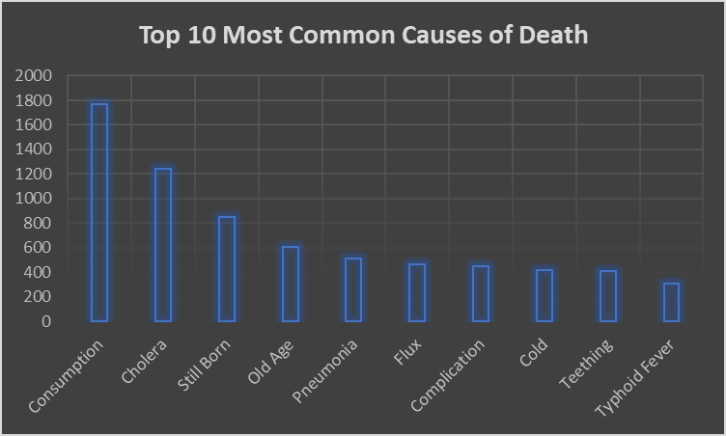
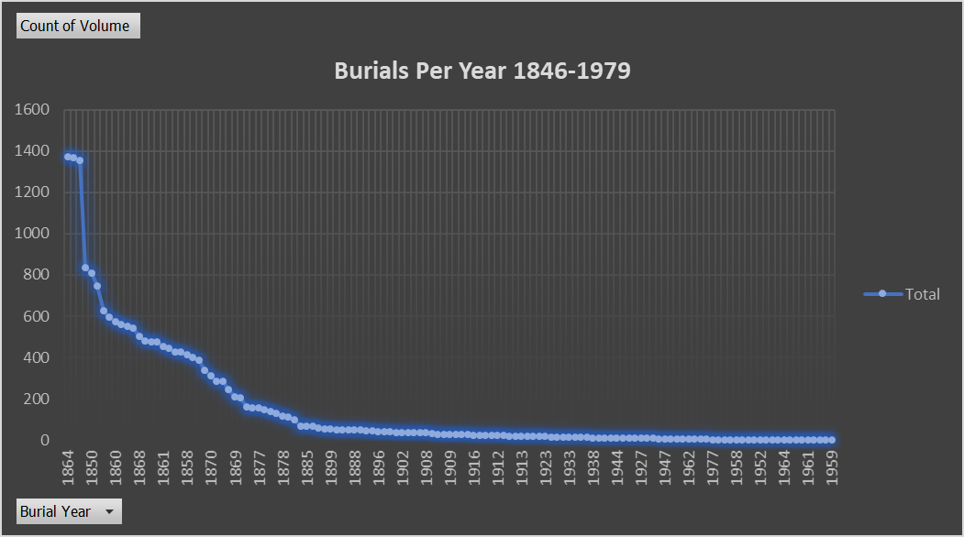
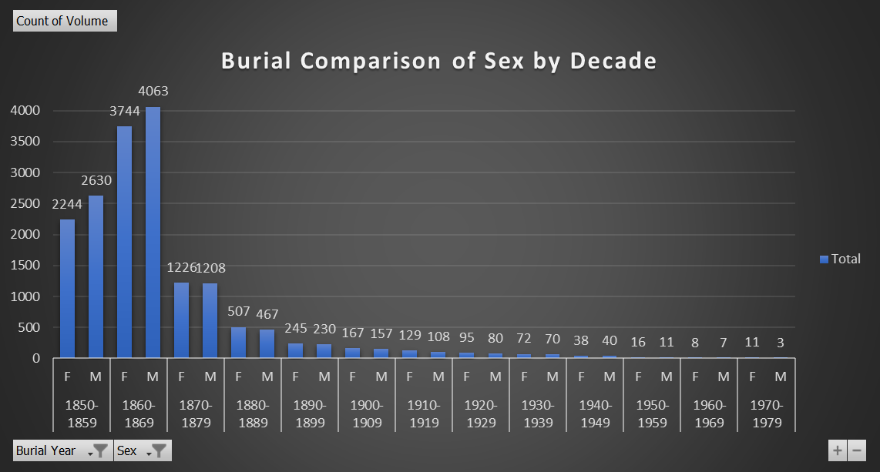

Dashboard

Slide 3
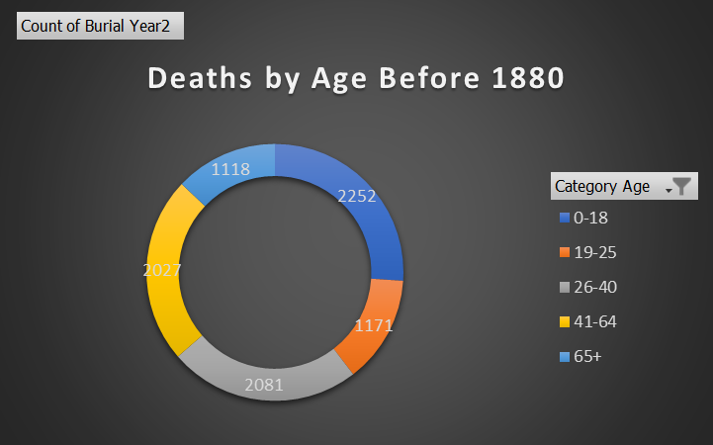
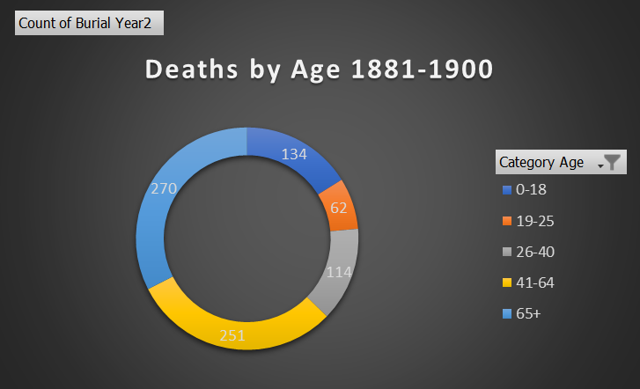
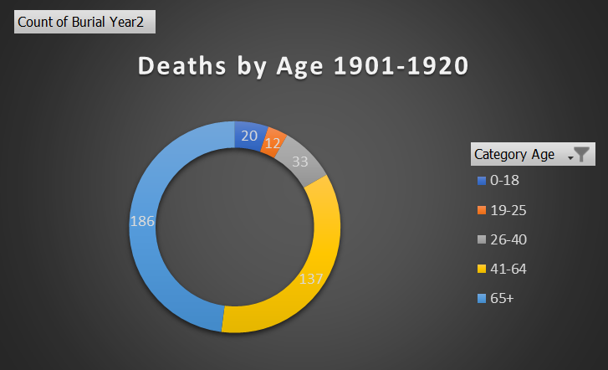
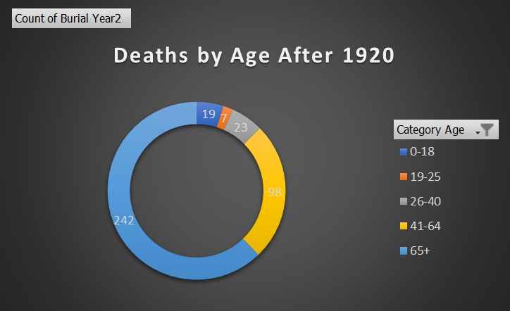
Dashboard

Slide 4
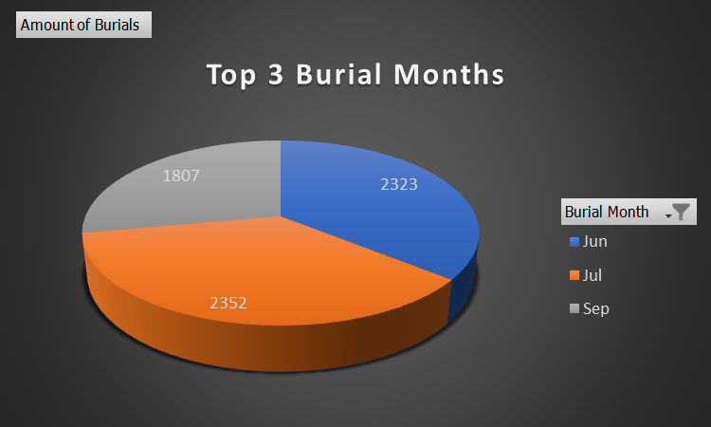
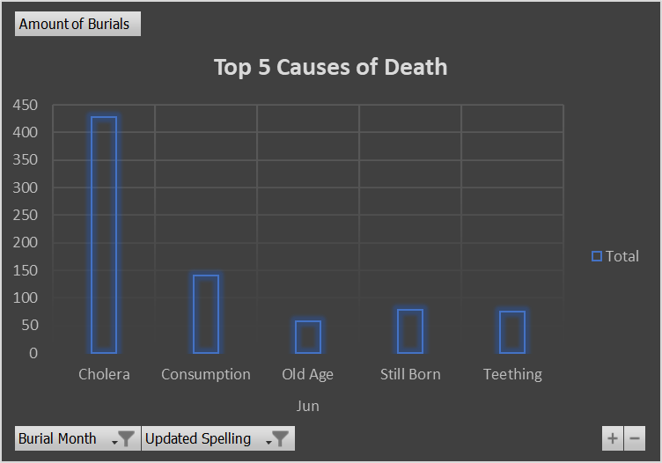
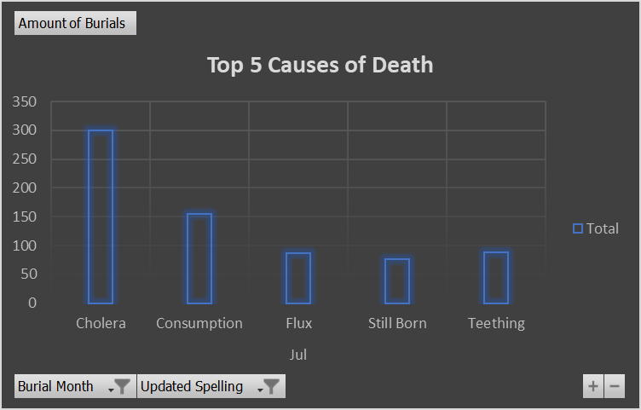

Dashboard

Slide 5
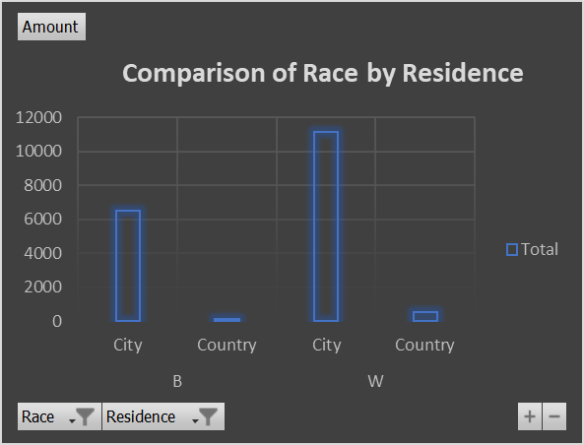
Dashboard

Slide 6
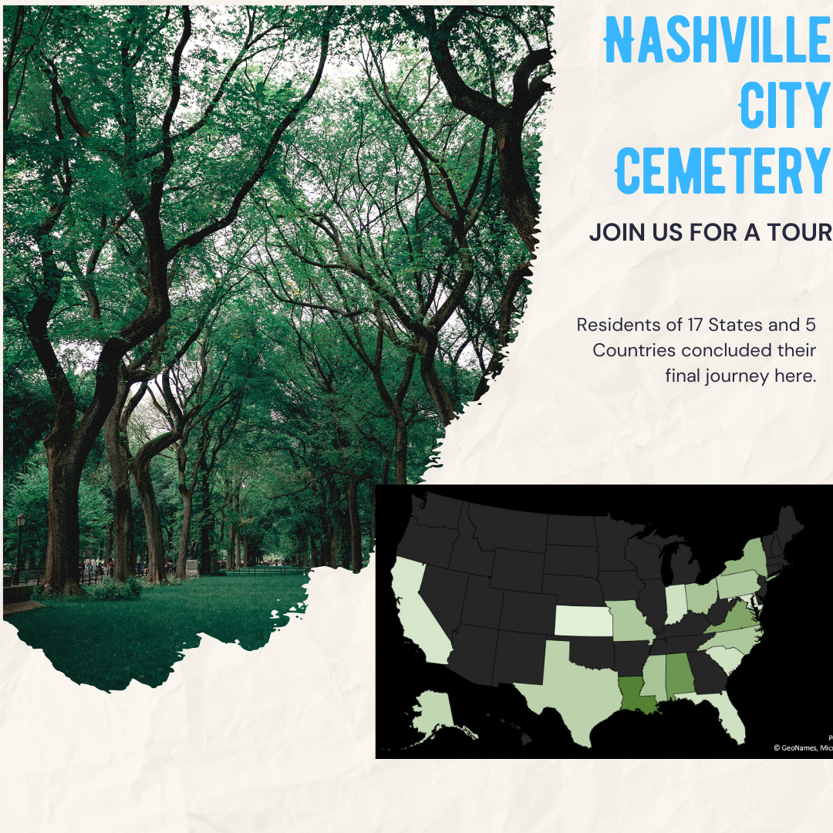

Slide 7
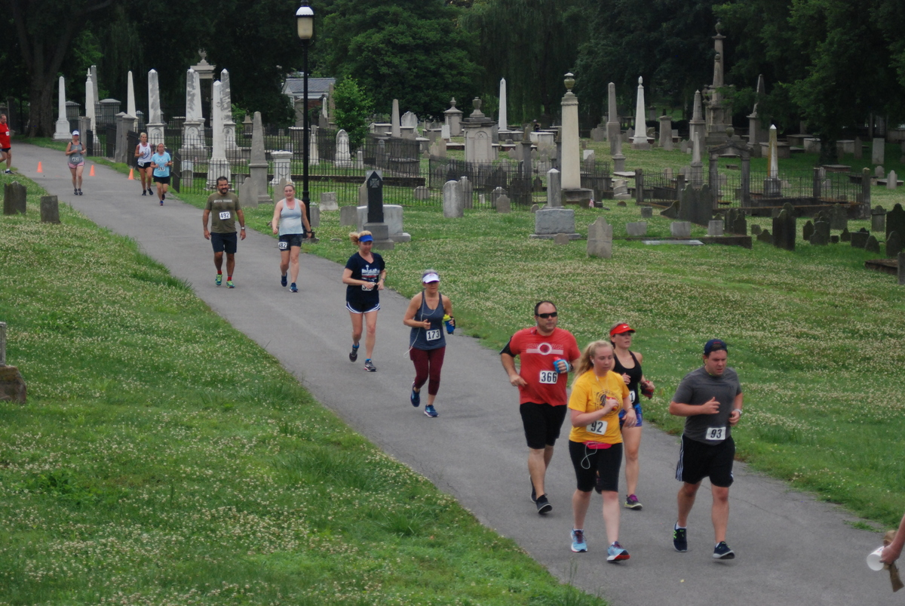
Findings & Recommendations
Revamp and utilize your social media accounts. Our society has become fully immersed in the digital era and by focusing in on this tactic your organization can reach the broad audiences you appeal to. Post engaging content that will draw interest to the history of the cemetery and activities hosted here.

Slide 8
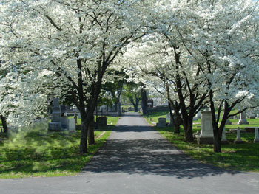
Thank you
Mylah Kate Gainey
www.linkedin.com/mylahkate​
DDA7
05/20/2022

